Slide 1
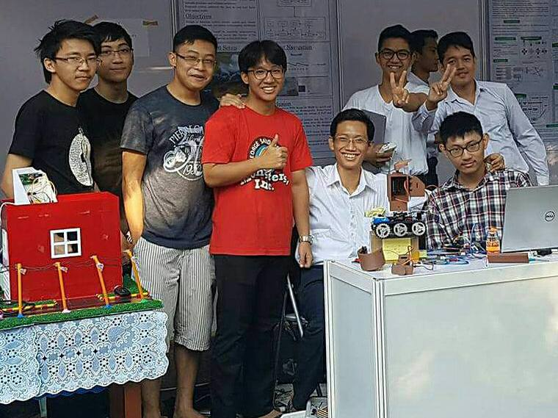
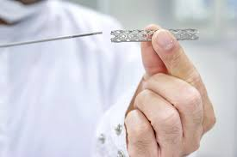
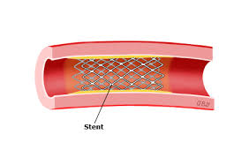
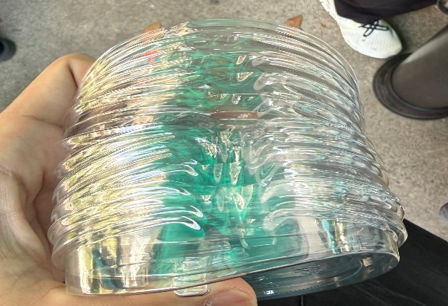

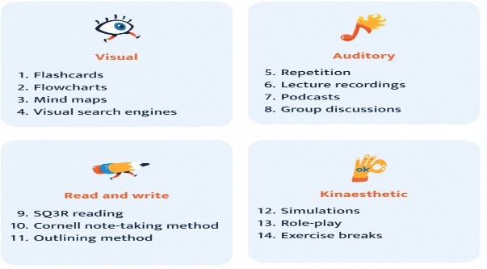

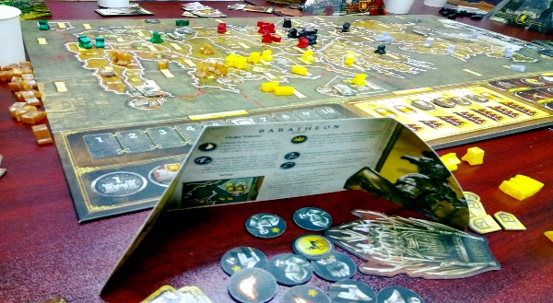
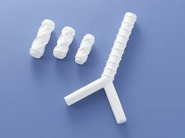
My Learning Catalog
Photo
Photo or illustration
Photo or illustration
THU TA ZAW
●● ●●
Affiliation
Graduate School of
Natural Science and Technology
Impressive classes/research
Future Dreams
self-introduction
I am a graduate student from Myanmar and I love physics. I love to play soccer in my free time.
My current research focuses on the design, modeling, and numerical analysis of braided Nitinol tracheal stents for biomedical and veterinary airway applications, with particular emphasis on mechanical stability and failure prevention. An equation-driven parametric approach is employed to construct accurate three-dimensional braided stent geometries, enabling systematic control of key design parameters such as braiding angle, wire diameter, pitch, and the total number of wires. This parametric framework allows efficient exploration of design variations and their influence on stent flexibility, radial strength, and axial stiffness. The mechanical response of the stent is represented using a nonlinear superelastic Nitinol constitutive model calibrated from experimental tensile testing data. This approach captures stress-induced phase transformation, hysteresis, and large deformation behavior, which are essential for realistically predicting stent performance under physiological loading. Finite element simulations are carried out to evaluate stress distribution, deformation patterns, and potential failure regions within the braided structure, providing quantitative insight into design-dependent mechanical behavior.
To replicate in-vivo operating conditions, coupled fluid–structure interaction (FSI) simulations are performed to investigate the interaction between obstructed airflow and stent deformation inside the trachea. These simulations clarify how airflow-induced forces contribute to stent compression, localized stress concentration, and long-term mechanical instability. By integrating parametric geometry, advanced material modeling, and FSI analysis, this research aims to establish robust design guidelines for braided tracheal stents, ultimately contributing to improved durability, safety, and clinical effectiveness in airway support applications.
My way! Useful learning methods to know
Kanazawa lifestyle recommendations (spots, stores, etc.)
Hobbies and Extracurricular Activities
Photo or illustration

